Slide 2
Active Recovery
Vicci Wells, National Lead for Targeted Interventions

Slide 3
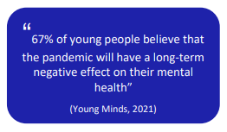
Why Active Recovery?
Every child and young person will have had their own unique, personal, lived in experience during the Covid-19 pandemic.
All will have experienced losses to their routines, structures, friendships, opportunities and freedoms. The result is that as pupils return to schools, they may arrive not feeling safe or secure. An anxious child ‘is not in a place to learn effectively’ (Carpenter 2020).

Slide 4
Older children have lost stamina in their reading and writing, some have lost physical fitness, others show signs of mental distress, including an increase in eating disorders and self-harm” OFSTED (NOVEMBER 2020)

Slide 5
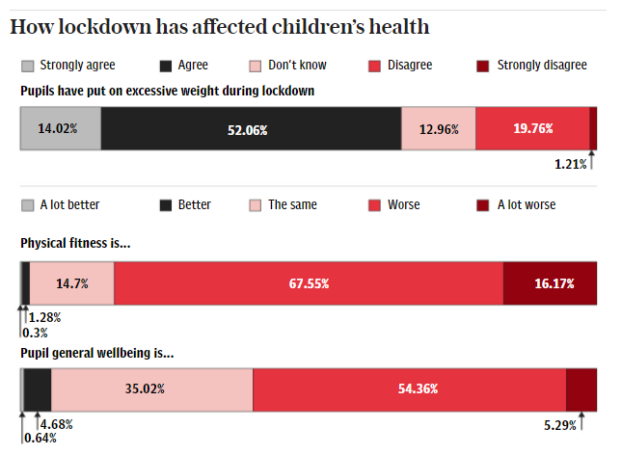
Schools Active Movement- May 2021
Notes:
The “horrific” impact of the third national lockdown has been laid bare in a major new study which found that 84 per cent of schools have identified a decline in children’s physical fitness and two thirds thought that pupils had gained excessive weight.
The survey, which was commissioned by the Schools Active Movement, and is the largest analysis of how the winter lockdown impacted young people, also records alarming drops in pupil resilience, activity levels, social interaction and fundamental movement skills.
Of 2,647 schools that were surveyed, teachers were asked to score how children had returned from nine weeks of lockdown between January 4 and March 8 according to a series of key physical and emotional measurements.
On the physical, 84 per cent of schools judged that children had experienced a decline in fitness, 66 per cent said that children had gained excessive weight and 67 per cent recorded a regression of pupils’ fundamental skills and movement.
Almost two-thirds of schools judged children to have a lower resilience and 60 per cent reported that the general wellbeing of pupils had regressed against an improvement of only 5 per cent.
The survey data also found that children in urban communities were more likely to have been impacted than those in rural areas surrounded by more open space.

Slide 6
Why Active Recovery?
51%
92%
34%
9 in 10 children felt the way they play had changed since the Covid pandemic.
Over half of children said they were playing outside with their friends less
One third of children were playing alone more
Notes:
Save the Children poll (May 2021) found:
The Save the Children survey was carried out by Beano Brain and polled 4,556 children between the ages of seven and 14 between 29 April and 4 May.
More than
Half (51%) said they were playing outside with their friends less
a third (34%) were playing alone more
and almost a quarter (23%) were playing less sport than before. closu

Slide 7
Why Active Recovery?
The recent Sport England Active Lives data reveals that active children are happier, more confident, resilient and trusting than their less active peers.

Slide 8
Physical activity is crucial to the way we think and feel… it can be the cue for the building blocks of learning in the brain, it affects mood, anxiety and attention, and guards against stress
JOHN J RATEY, HARVARD UNIVERSITY (2008)
Notes:
Healthy children attend school more regularly. Furthermore, physically-active children do better in school regardless of where they engage in PA (Donnelly et al., 2016). More specifically, physical activity during the school day benefits cognition and academic performance (Best, 2010); potentially by capitalising on repeated acute responses. A recent meta-analysis found that higher levels of PA within the school day were associated with improved classroom behaviour, math performance, reading and overall composite scores of school performance (Alvares-Bueno et al., 2017).
Every child and young person will have had their own unique, personal, lived in experience during the Covid-19 pandemic.
All will have experienced losses to their routines, structures, friendships, opportunities and freedoms.
The result is that as pupils return to schools, they may arrive not feeling safe or secure. An anxious child ‘is not in a place to learn effectively’ (Carpenter 2020).
Children’s activity levels fell during the first lockdown and there is acute concern that their fitness and well-being will have plummeted even further during the second period of school closures.
The recent Sport England Active Lives data reveals that active children are happier, more confident, resilient and trusting than their less active peers.
Schools are invited to prioritize physical activity and time outdoors as their pupils return. Active recovery harnesses the benefits of play and sport to young people’s self confidence, self belief, sense of belonging, re-socialisation as well as their physical and mental heath.

Slide 9
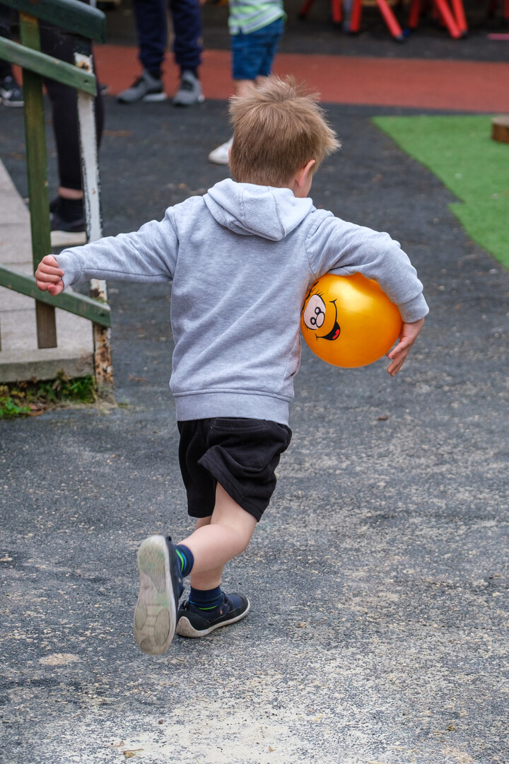
The evidence
Increased participation in daily physical activity and reduced sitting time
Improved physical, social and emotional wellbeing
Improved behaviour and cognition leading to increased progress and achievement

Slide 10
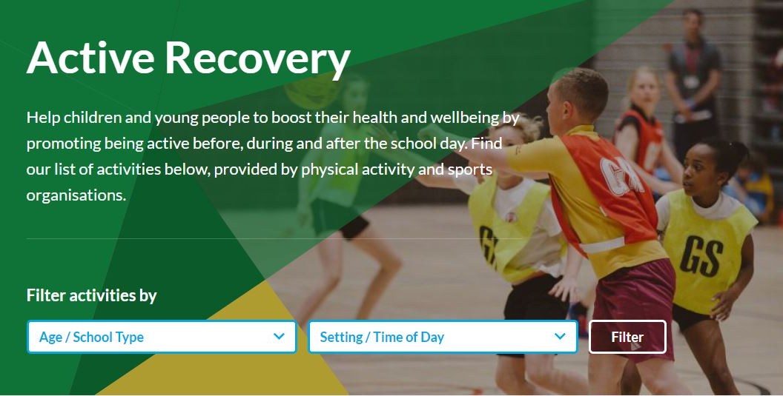
Active Recovery Hub
What is it?
Who is it for?
Who is involved?
Parameters
Fit for purpose
Activities

Slide 11
Impact of COVID
The pandemic has had such a devastating impact on the social and emotional wellbeing of our children, causing high levels of mental distress. Active Recovery offers a positive and proactive route to recovery which builds physical fitness, stamina and social skills.” PROFESSOR BARRY CARPENTER CBE,OBE,PhD

Slide 12
Sport and Sensory Sanctuaries as part of Active Recovery

Slide 13
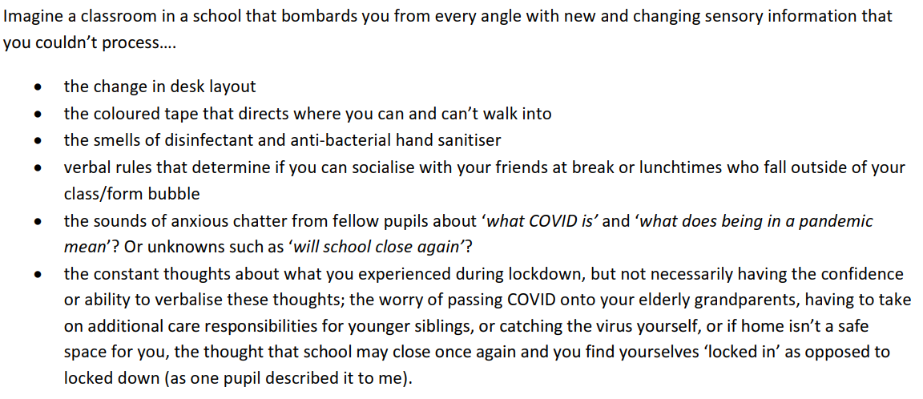
Close your eyes….

Slide 14
Close your eyes….

Slide 15
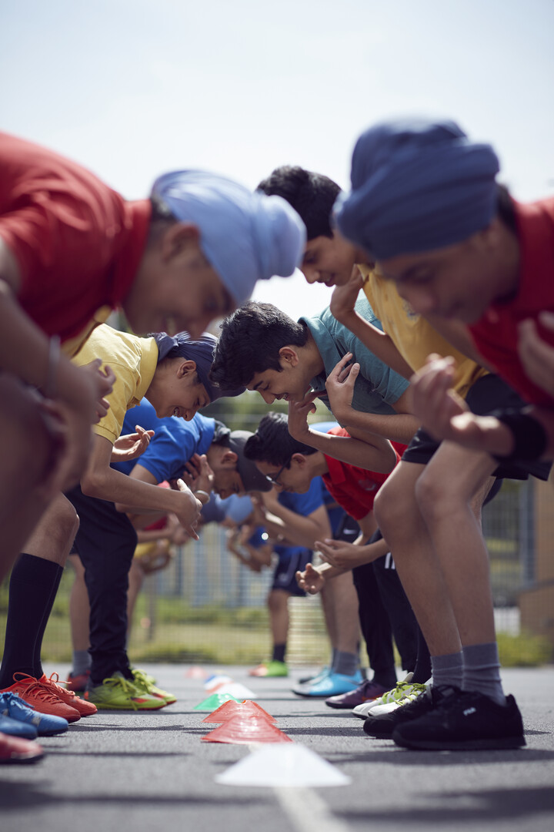
Opportunities
Lever 1: Relationships
Lever 2: Community
Lever 3: Transparent curriculum
Lever 4: Metacognition
Lever 5: Space
RECOVERY CURRICULUM, CARPENTER & CARPENTER (APRIL 2020)

Slide 16
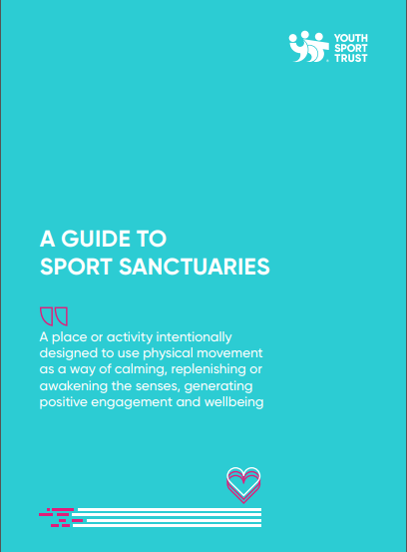
As pupils adjust to being back in school following the Covid-19 pandemic, educators may need to provide additional support for their pupils not least more opportunities to be active, outdoors, reconnecting and rebuilding their learning confidence.
Through the co-construction of a sanctuary within school between pupil and educator, effective strategies focusing on activity and sensory processing can be designed.
This will result in happier, healthier young people who are engaged and ready to learn.

Slide 17
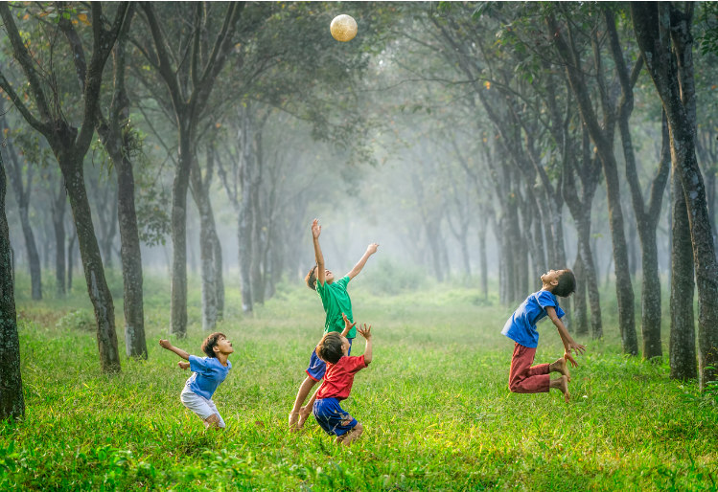
What does the word sanctuary mean to you?

Slide 18
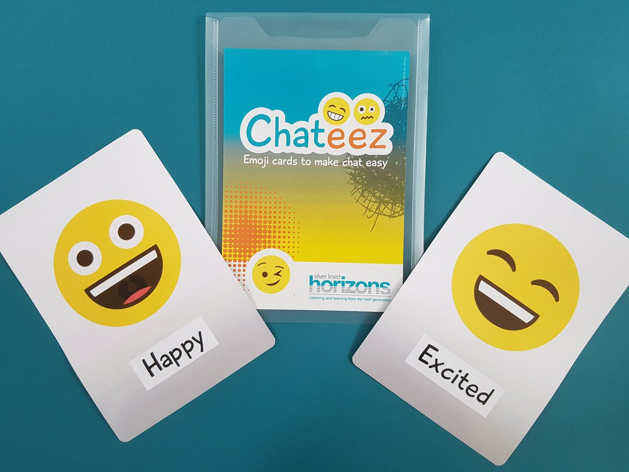
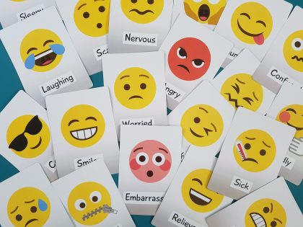
Let’s spark a conversation….

Slide 19
Sport Sanctuary
A place or activity intentionally designed to use physical movement as a way of calming, replenishing or awakening the senses, generating positive engagement and wellbeing’
VICTORIA WELLS, 2021

Slide 20
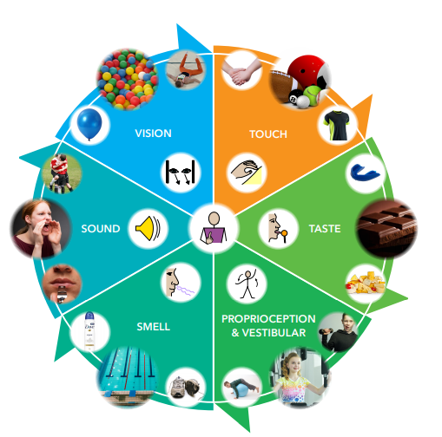
Sensory Processing

Slide 21
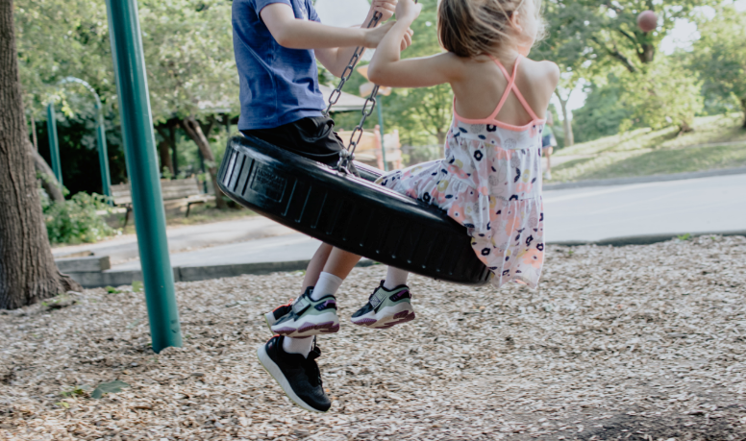
How could a Sport Sanctuary support pupils?
New neural pathways= Learning pathways!
New activity!
What are we planning to teach children and young people in the coming months?

Slide 22
The evidence
those who do more physical activity are likely to have stronger ‘self-regulation’ – the ability to keep themselves in check – and in particular may find it easier to control their emotions at an earlier age. Physical activities which promote self-control in this way, such as swimming or ball sports, also have positive, knock-on effects for academic attainment.
Vasilopoulos F, Ellefson MR (2021). https://doi.org/10.1371/journal.pone.0250984 (University of Cambridge)

Slide 23
The impact…..

Slide 24
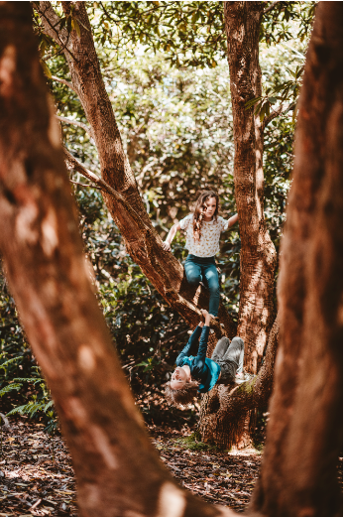
The approach
Make Aware Help young people to identify what their sanctuary is- is it a place? Is it an activity? Is it a feeling?
Practice Give young people opportunities to practice, rehearse, discuss, plan and reflect
Apply with Support Give young people opportunities to apply skills with support from you (scaffolding learning)
Encourage Independent Use self pace and self regulate. Whose learning is it anyway?

Slide 25
Examples in practice
Riverside School, Co.Antrim, Northern Ireland Their sports sanctuary has green space, trees and the relaxing sounds of nature and encompasses individual and group activities with opportunities to learn new skills.
Clare Mount Specialist Sports College, Wirral, Merseyside- menu of activities designed in 5-minute bursts and chosen by pupils that stimulate vestibular or proprioceptive senses
Baxter College, Worcestershire (Secondary Mainstream) Lunch ‘astro time’ creates the space for pupils to be physically active in an outdoor space
Notes:
Riverside School, Co.Antrim, Northern Ireland (Special)- are working with pupils to co-create sanctuaries in school. Focusing on creating a sports sanctuary outside and a sensory sanctuary inside, they are designing activities that either calm or alert pupils. Their sports sanctuary has green space, trees and the relaxing sounds of nature and encompasses individual and group activities with opportunities to learn new skills. There is a focus on pupil led activities and physical exercise.
Clare Mount Specialist Sports College, Wirral, Merseyside- have developed a menu of activities designed to be undertaken in 5-minute bursts and chosen by their pupils that stimulate vestibular or proprioceptive senses. These include:
Linear vestibular: rowing machines, trampoline, football passing and basketball dribbling activities with a teaching assistant, a walk on the field out to the Forest School site, throwing a Vortex howler on the field or bowling at a playground target, using the playground gym equipment, the playground swing or the indoor sensory room.
Proprioceptive: Cycling, in-line skating, scootering, therapy ball activities, scoot boarding and using Forest School as a movement break e.g. joining in with some wood-chopping or fence removal.
Sandbach School (Alternative Provision), South Cheshire-focus on outdoor education and climbing spaces to support pupils with letting off steam by being outside and physically exerting themselves.
Lawnswood Campus (Alternative Provision), Wolverhampton-have created dedicated sport sanctuaries drawing upon pupils’ interests, such as boxing. Pads are provided that enable pupils to visit the sanctuary if they need to ‘take 5’ before returning back to class engaged and ready to learn.
Alfriston School, Buckinghamshire created wellbeing walks that pupils know they can participate in at break and lunchtimes, designed to boost mood and overall wellbeing through activity.
Foxfield School, Birkenhead (Special)- Use the pool as their sport sanctuary. Pupils share that swimming can provide a sense of freedom in a different environment not found elsewhere.
Baxter College, Worcestershire (Secondary Mainstream) Lunch ‘astro time’ creates the space for pupils to be physically active in an outdoor space that provides opportunity for positive relationships to be established between staff and students.
Whitfield Aspen School, Dover- Recognised that whilst they have sensory spaces in school, there was a need to create a sanctuary for pupils who just want and need to move. This has been established outdoors in the school grounds.

Slide 26
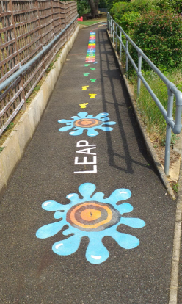
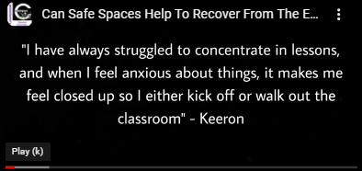
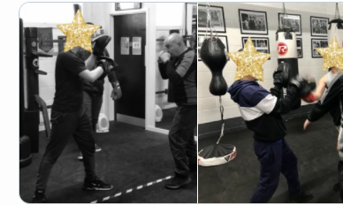
Examples in practice
Notes:
Lawnswood Campus (Alternative Provision), Wolverhampton-dedicated sport sanctuaries drawing upon interests, such as boxing.

Slide 27
Parent/Carer priorities
The most important factor for parents when deciding on a secondary school was the wellbeing of pupils (65%).
The most important factor for parents when choosing a primary school was location (68%) followed by wellbeing (63%)
Two out of three parents agreed or strongly agreed they would like to see more information on what schools were doing to support wellbeing of pupils.
58% of parents agreed wellbeing was likely to be better in schools which prioritised sport, Physical Education and physical activity.
Notes:
Primary schools- wellbeing was second after location Ofsted rating (51%), facilities (46%) and then enrichment programmes offered by the school (43%)
Secondary schools it was first
Two out of three parents (68%) agreed or strongly agreed that they would like to see more information on what schools were doing to support the wellbeing of pupils and 70% said it should be easier to find this out. In contrast, less than half of parents (43%) said they currently felt well informed on what their child’s school was doing to support wellbeing
Ofsted research parents 2021
Two thirds of parents report being concerned about the impact of COVID-19 on their child’s learning loss (67%). This is followed by concern over mental health (65%) and physical health (45%).

Slide 28
Thank You
https://www.yourschoolgames.com/active-recovery/
@YouthSportTrust
@vawells1

