Slide 1
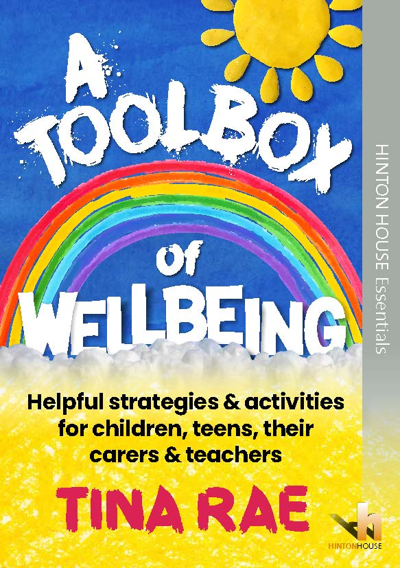
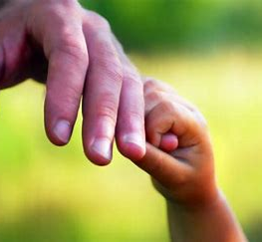
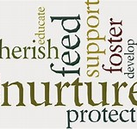
Presented by Dr Tina Rae
Ways to Recovery through A Toolbox of Wellbeing
15.7.20.

Slide 2
The role of the Mental health lead in schools
Teacher, Psychologist, Author, Therapeutic supervisor
nurtureuk.org/our-services/publications

Slide 3
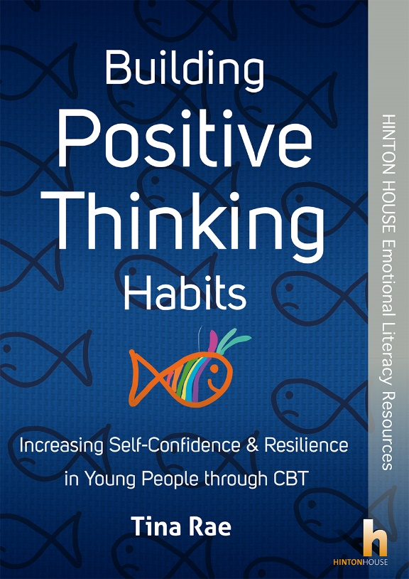
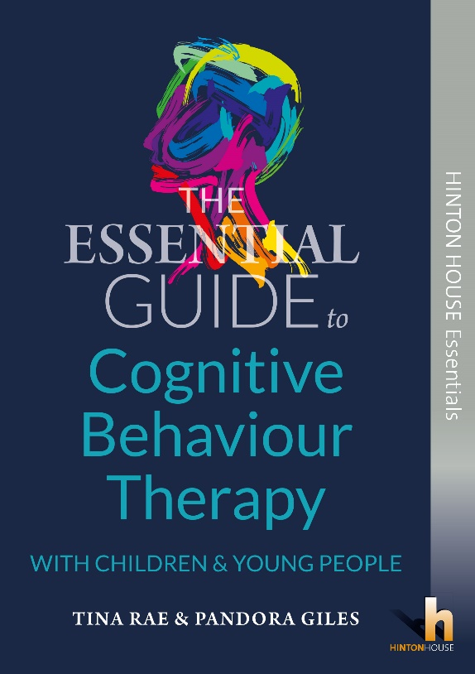
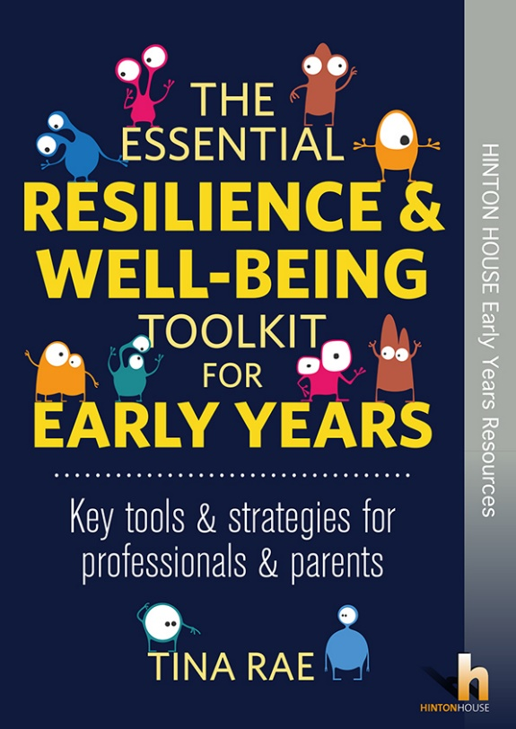
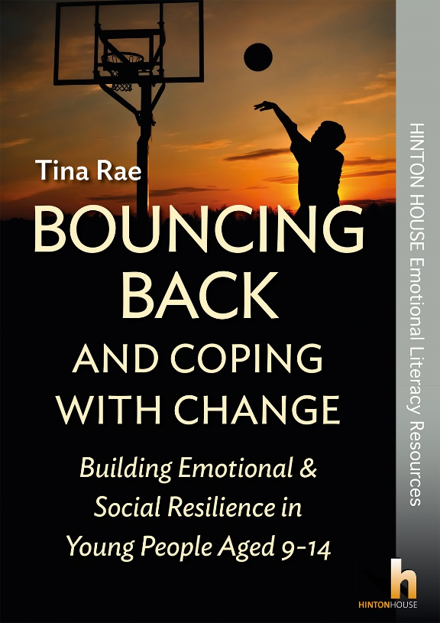
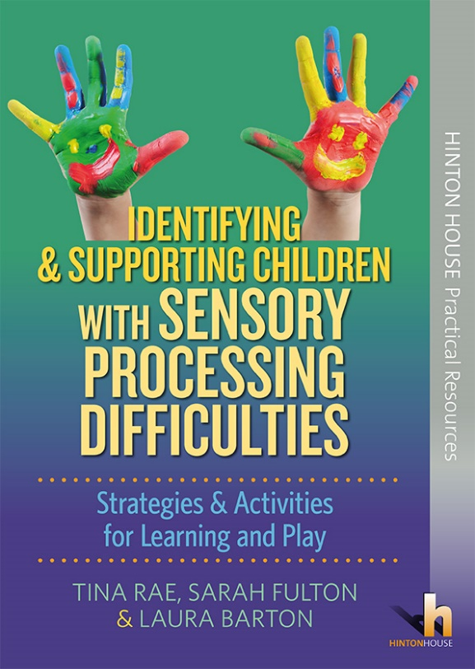
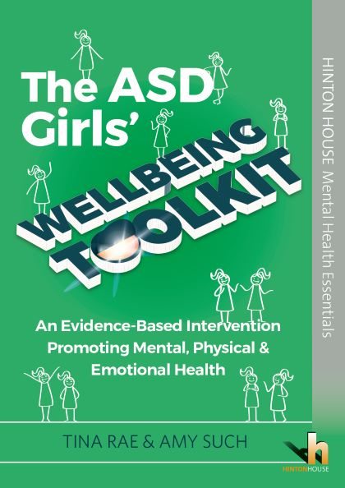
Dr Tina Rae publications sales@hintonpublishers.com

Slide 4
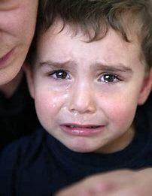
Conversation overheard
Boy (aged 8 approximately) Mummy why do you have to go to work? I don’t want you to go. I’m worried you’ll get the virus
Mum: I’ve got to go in darling. I’m an essential worker. I have to be there
Boy: But you might die
Mum: We’ll all die someday darling but I’m being careful so you mustn’t worry
Boy: But I feel sick when you go. You might not come back. I think we should just all stay at home – it’s safer. We can’t be safe anywhere else.

Slide 5
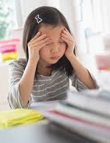
COVID-19 effects
A recent survey undertaken by the charity Young Minds (2000 YOUNG PEOPLE WITH EXISITNG CONDITIONS) in March 2020 revealed that the current coronavirus pandemic is having a profound effect on young people with existing mental health conditions.
83% of those who took part in the survey reported increased anxiety, problems with sleep, panic attacks or more frequent urges to self-harm.
CO-SPYCE study UNIVERSITY OF OXFORD – one fifth of children do not now feel safe to leave their homes

Slide 6
On-going abuse for AND neglect of the most vulnerable

Slide 7
The task – to create AND RESOURCE a Recovery curriculum
Trauma informed
Nurturing
Well being first

Slide 8
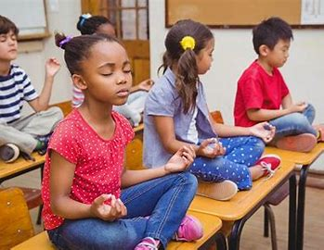
Creating the Trauma informed classroom – creating a safe base – 6 keys (thanks to Dr Chris Moore)
Belonging
Predictability
Organisation
Regulation
Differentiation
Relationship

Slide 9
Since we last met…….

Slide 10
My impetus
‘Never has there been a time when knowing how to manage our own well-being and how to support our children in doing this has been so vital’. Tina Rae

Slide 11
A must-have book full of easy to use activities to build emotional wellbeing in all children and young people and to support the recovery curriculum in schools in response to the COVID-19 pandemic.
For use by all parents, carers, teachers and others concerned with the wellbeing of children and young people, with much needed practical advice and support to protect mental health and wellbeing at a time of uncertainty and fear.

Slide 12
This little book will provide children, young people and their carers with user-friendly, easy to understand and evidence-based strategies to build good mental health, and to build the resilience needed to move on from stressful situations and trauma – including those related to the current Coronavirus pandemic.

Slide 13
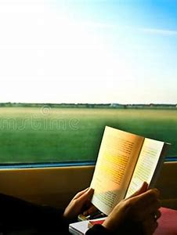
MY FRIEND AND NEIGHBOUR SAID……(or the need for adult self-regulation?)
‘Thank you so much….I can pop this in my handbag and read it on the train on my way to work. It will be much better than reading the anxiety provoking newspaper - especially in terms of my mental health and that of my kids. All that gives me is an awareness that I have no control so I get stressed. This will help me take back some of that and maybe stop stressing about stuff I cannot control.’

Slide 14
The activities are divided into sections for younger children, teenagers and whole groups or classes, and are grouped under the three key trauma recovery approaches of ‘Self-Regulate for Wellbeing’, ‘Get Moving Mentally & Physically for Wellbeing’ and ‘Connect for Wellbeing’.

Slide 15
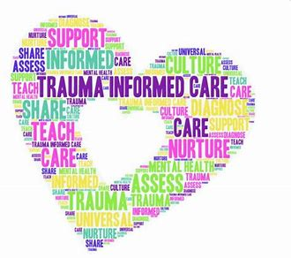
The need for us ALL to engage in the 3 Trauma Recovery approaches
Self-Regulate for Wellbeing
Get Moving Mentally & Physically for Wellbeing
Connect for Wellbeing

Slide 16
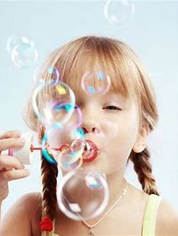
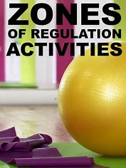
Part 1 Self-regulate for well being
identify and modulate emotions
control impulses
delay gratification
make thoughtful and conscious choices
and set goals and achieve them.

Slide 17
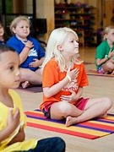
Are we modelling this?
Emotional self-control is based mainly on our ability to calm down in the face of anger and frustration.
Cognitive self-regulation boils down to our problem-solving abilities.
And then there is social self-control, meaning our capacity to refrain from just saying whatever pops into our mind, especially when those thoughts are unkind or negative.

Slide 18
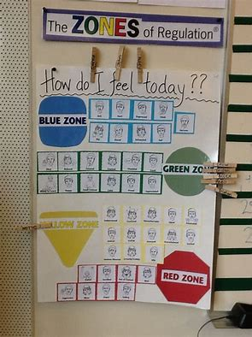
5 ways for adults to self regulate – simple?!
Breathe deeply. When stressed, it is a natural human response to take short, shallow breaths. Stop for a moment and take three to ten slow, deep breaths.
Drink water. Our nervous systems are far more sensitive when we are dehydrated. Stay hydrated to stay calm.
Pause. Just take a moment to pause and centre yourself. Place your hand over your heart; practice this throughout the day.
Think. Recall what you love about the child or young person or a successful experience you had with them. This releases positive neurotransmitters to balance out negative brain chemicals produced by frustration and stress. It is a fact that we can self-regulate our own nervous systems.
Visualize. See the positive outcome in your mind. Practice visualization: it is an immensely powerful and effective tool not to be underestimated.

Slide 19
Make a calm down jar!
To make your own calm down jar, mix glitter glue with hot water, add a few drops of food colouring. Whisk until the glue ‘melts’ and mixes properly with the water. Next, add additional glitter, whisk vigorously one more time, transfer the mixture into your clear jar, and top the bottle up with water so it’s completely full. Allow the water to cool to room temperature before securing the lid with glue to ensure it is properly sealed and won’t leak. Shake when you need to calm down

Slide 20
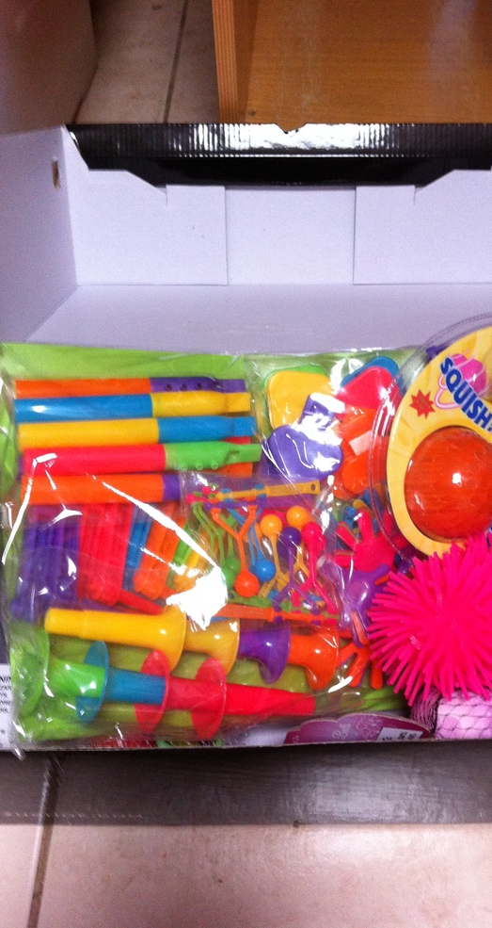
Try the 5-4-3-2-1 method
Working backward from 5, use your senses to list things you notice around you. For example, you might start by listing five things you hear, then four things you see, then three things you can touch from where you’re sitting, two things you can smell, and one thing you can taste. Try to notice the little things you might not always pay attention to, such as the colour of the flecks in the carpet or the hum of your computer.

Slide 21
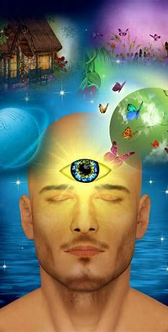
Imagine yourself leaving the painful feelings behind
Picture yourself:
gathering the emotions, scrunching them up, and putting them into a box
walking, swimming, biking, or jogging away from painful feelings
imagining your thoughts as a song or TV programme you dislike, changing the channel or turning down the volume — they’re still there, but you don’t have to listen to them.

Slide 22
Part 2 Get moving mentally and physically for well being
The mental agility in analysing and challenging our negative thinking patterns and the need to be agile physically in order to produce those feel good chemicals in the brain are the focus of the next section of the book.

Slide 23
CBT – RECOGNISING THINKING ERRORS!
Doing ourselves down – only focusing on the negatives and seeing bad things about ourselves.
Blowing things up or catastrophising – making things worse than they really are.
Predicting failure – setting your mind ready to predict failure whatever the situation.
Over emotional thoughts – this is when your emotions become extremely powerful and stop you thinking clearly.
Setting yourself up – setting yourself targets that are too high so that you know that you will fail.
Blaming yourself – thinking that everything that goes wrong is your own fault.

Slide 24
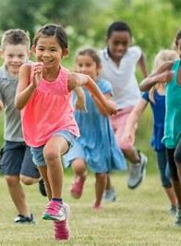
Physical fitness and being in Nature
1. It gives children a break from busy schedules
2. physical activity lowers anxiety
3. It has a positive impact on mental health
4. It helps children top up on vitamin D which releases serotonin (which helps regulate emotion and mood and is linked to happiness) in the brain
5. The outdoors relieves stress and anxiety as time spent playing outdoors is thought to help relieve stress and anxiety for children by reducing levels of the hormone cortisol in the brain.

Slide 25
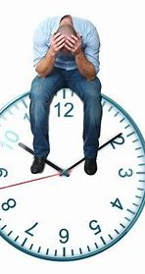
Worry time
Think about your day and find a time in it when it would be okay to worry – no more than five or ten minutes is needed. This is your special ‘worry time’. When you find yourself worrying at a time when you have other things to do (like at bedtime, or while you are trying to concentrate on something else), tell yourself to stop and put off the worries for later, during your worry time.

Slide 26
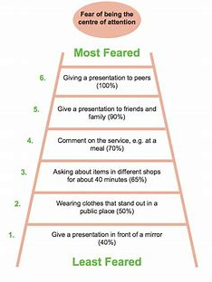
Facing my fears using the Anxiety Ladder
You can face your fears by using an ‘Anxiety Ladder’. This involves working out as many gentle steps as possible to build up exposure to the feared thing.
For example, if you are afraid of dogs, a ladder may begin with hearing about a dog or looking at a picture of one.
You can draw a ladder with 10 or more steps and then write down all the gentle, easy steps you think you could take to face and conquer your fear. You can write each step on each rung. Begin at the easiest step on the ladder and build up very, very slowly, noticing and celebrating every step of the way.
What will happen is that you will build up good evidence over time that it is okay to be with the feared object – that fears are not there forever and that we can do something about them.

Slide 27
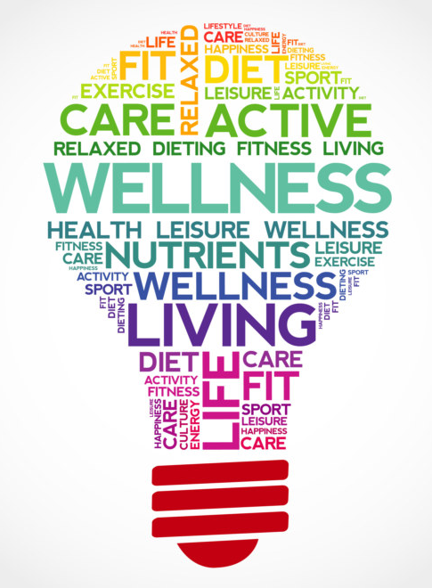
ACT!
There are many ways of managing emotions and boosting well-being and self-esteem.
These can be placed under 3 headings:
Active ones – running, swimming, singing
Calming ones - Mindfulness and relaxation
Thinking ones – challenging negative thoughts
What do you do now for each one? What could you do more of?
Make a list of what you do now and try to think about how many times each week you do these to boost positive feelings and emotions. Keep an ACT diary for a week so you can work out what worked when and what did not work quite so well for you.

Slide 28
Part 3 Connect for well being
Connections matter. Strong ties with family, friends and the community provide us with happiness, security, support and a sense of purpose. Being connected to others is important for our mental and physical wellbeing and can be a protective factor against anxiety and depression.
It is well established that we are social animals who thrive for connection, love and strong and meaningful interactions with other people. Research shows that our brain activates pain centres when we are at risk of becoming isolated.
Building positive relationships has a contagious effect and, in turn, offers us support in difficult times – DURING THIS PANDEMIC.

Slide 29
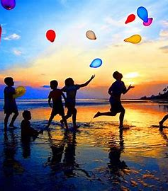
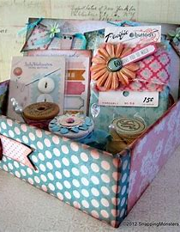
HAPPY MEMORIES
It is important to support children to understand that happy memories are an important part of maintaining wellbeing. Introduce children to the idea that they may find it helpful to think about happy memories when they are finding something tough, lots of people do this and find it helpful. Make a happy memories book/box!

Slide 30
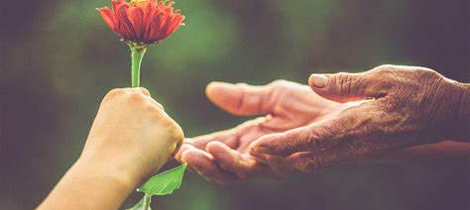
3 KIND ACTS
Practice this every day. Do things that make others feel happy and loved. The little things really do count- writing a note, a message, helping out or making a small gift.
Keep a diary to record your kind acts and reflect on this at the end of every week. How do you feel and how do you feel your acts have impacted upon others?

Slide 31
Social Media - Not all negative!
Don’t forget that used in the right way social media can help you. You can keep in touch with friends, post things to make others feel better about themselves and share good advice. Create a kind messages WhatsApp group. What will you post and share?

Slide 32
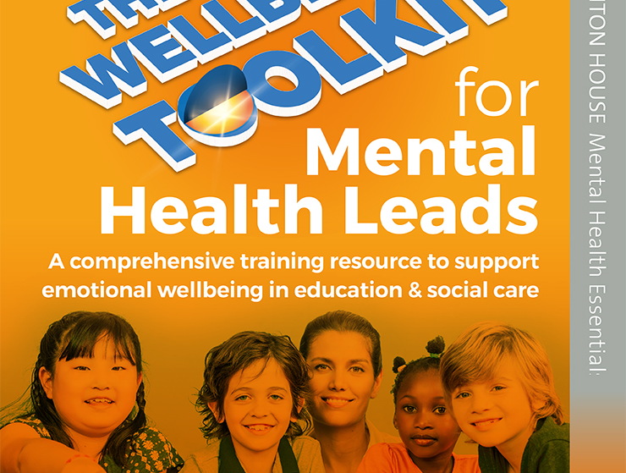
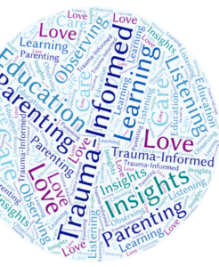
THE NEED TO UNDERSTAND Trauma and anxiety

Slide 33
Key take away messages
Safety first
Nurture, structure and re building relationships are key
Understanding and managing the outcomes of your trauma experiences essential
Need to avoid retraumatising children by focusing on negatives/sharing these
Start with what helped us to cope in Lockdown and build on this
Highlight the fact that we can be physically distant but STILL emotionally connected to each other
Make sure the most vulnerable get the right support at the outset
Do it differently – the old behaviourist approaches do not work and will need to be replaced by trauma sensitive classrooms and practice and NURTURE FOR ALL.

Slide 34
Key take away messages FINALLY…….
Embed the 3 Trauma recovery approaches in your Recovery plan for the school both at a systems and curriculum level
Self-Regulate for Wellbeing
Get Moving Mentally & Physically for Wellbeing
Connect for Wellbeing

Slide 35
REMEMBER! THERE ARE SO MANY RESOURCES OUT THERE NOW!

Slide 36
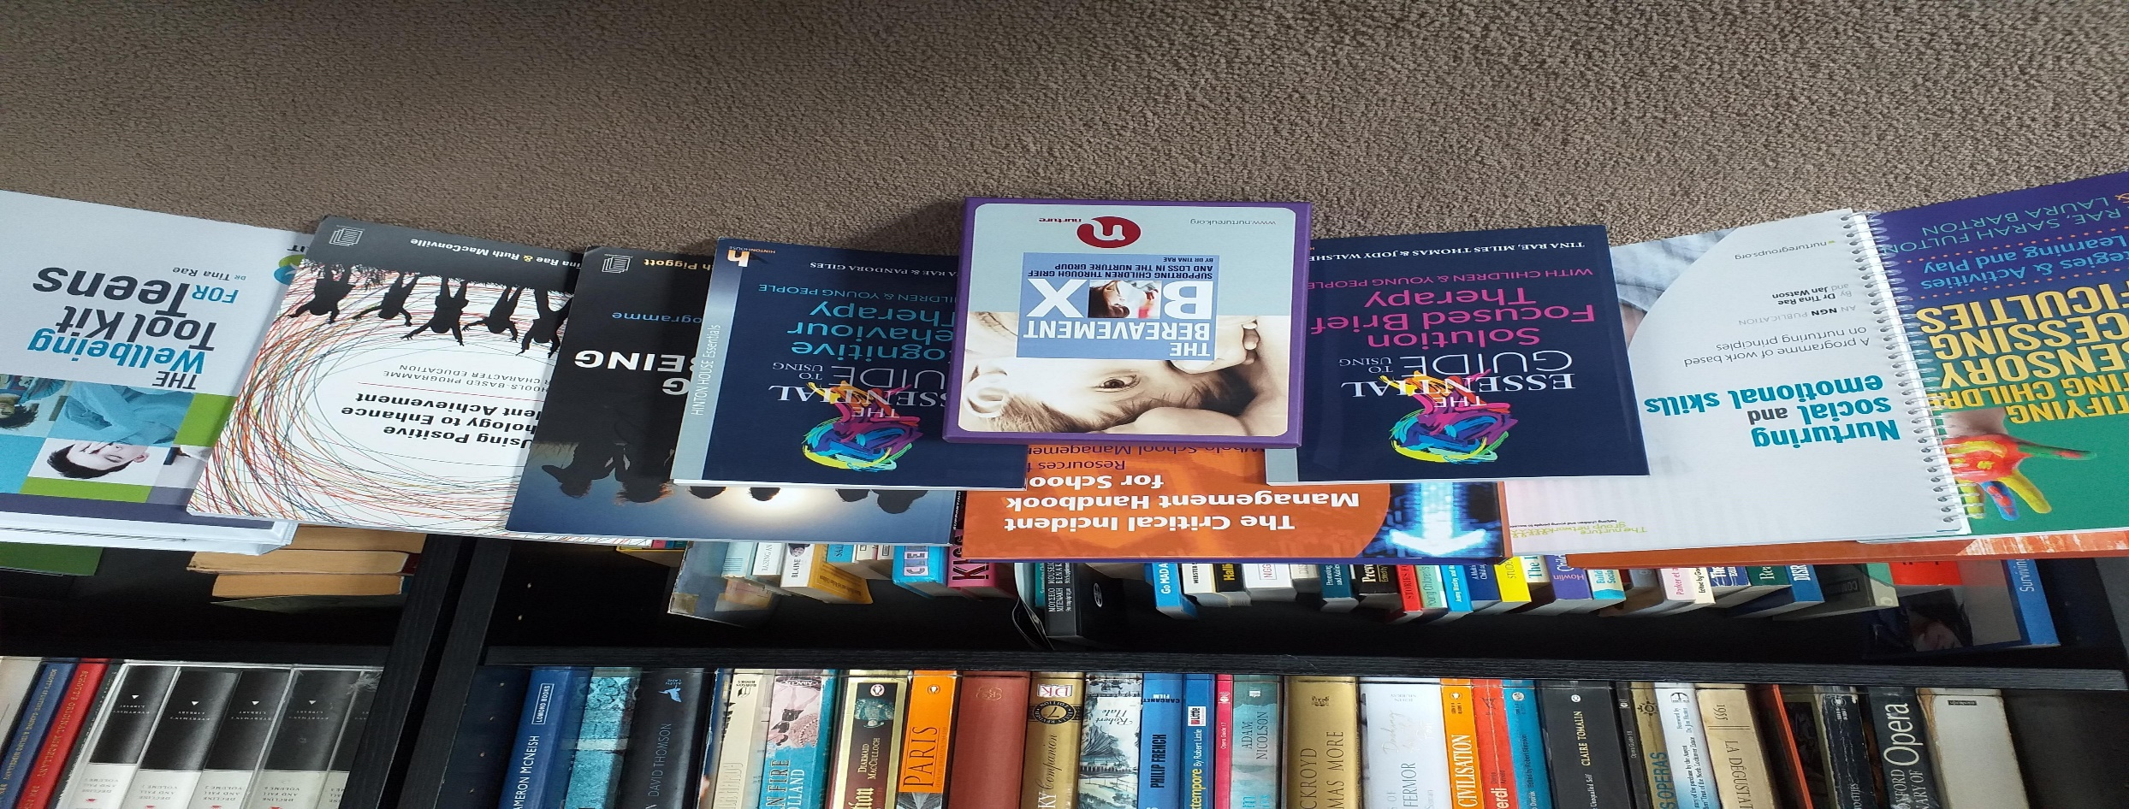
THANK YOU FOR LISTENING Dr Tina Rae tinarae@hotmail.co.uk @DrTinarae

